Slide 1
Advanced JavaScript
JS
Presented By : Asmaa Ahmed

Slide 2
Arguments Object
In JavaScript, the arguments object is a local variable available within all non-arrow functions. It provides a collection of all the arguments passed to the function. This can be particularly useful in functions that accept a variable number of arguments, or where you don't know the number of arguments that will be passed.

Slide 3
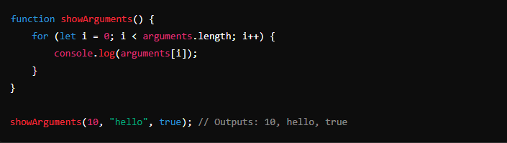
Arguments Object
Accessing Arguments
The arguments object works like an array but is not a real array. It allows you to access each argument passed to the function using an index, similar to array indexing.

Slide 4
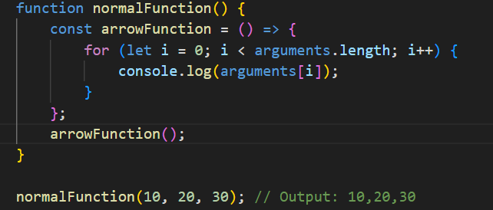
Arguments Object
Arguments and Arrow Functions
It's important to note that the arguments object is not available in arrow functions. If you try to use arguments in an arrow function, it will refer to the arguments of the nearest non-arrow function scope.

Slide 5
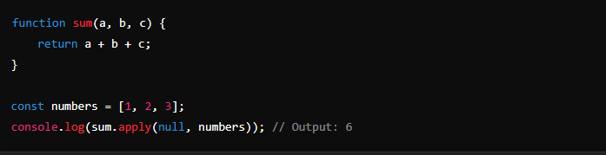
Apply , Call , Bind
Apply()
The apply() method calls a function with a given this value, and arguments provided as an array (or an array-like object).

Slide 6
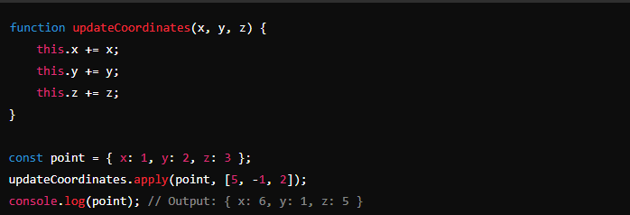
Apply , Call , Bind
Apply()
The apply() method calls a function with a given this value, and arguments provided as an array (or an array-like object).

Slide 7
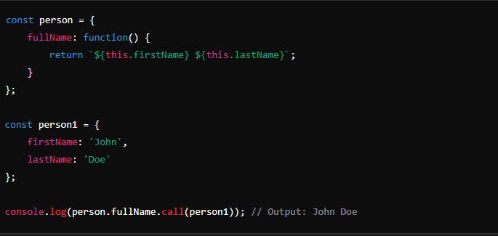
Apply , Call , Bind
call()
The call() method is very similar to apply(), but instead of taking an array of arguments, it takes them individually after the this value.

Slide 8
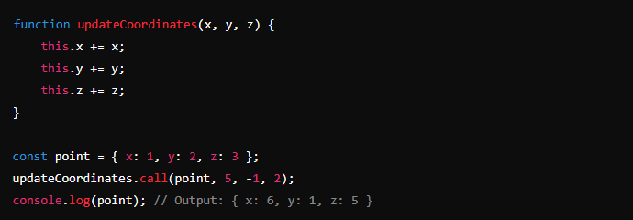
Apply , Call , Bind
call()
The call() method is very similar to apply(), but instead of taking an array of arguments, it takes them individually after the this value.

Slide 9
Apply , Call , Bind
bind()
The bind() method creates a new function that, when called, has its this keyword set to the provided value, with a given sequence of arguments preceding any provided when the new function is called.

Slide 10
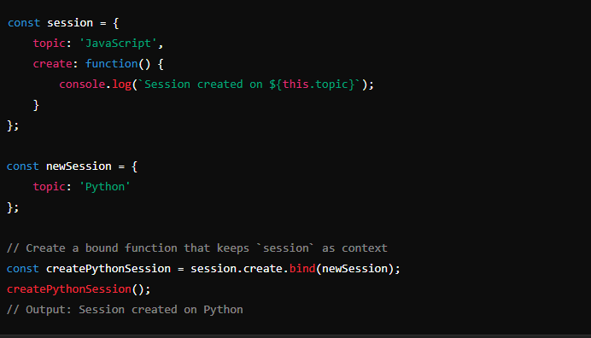
Apply , Call , Bind
bind()

Slide 11

Error Object
The generic Error constructor represents errors that occur during runtime. It's the base type from which all other error types inherit.

Slide 12
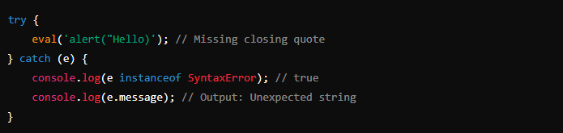
Error Object
SyntaxError
A SyntaxError is thrown when there are errors in the syntax of the code, which the JavaScript engine cannot parse.

Slide 13
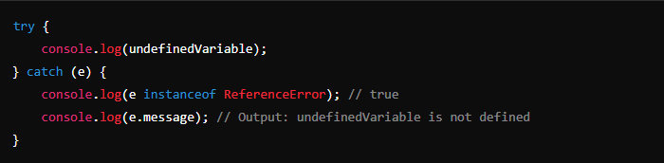
Error Object
ReferenceError
A ReferenceError is thrown when trying to access a variable that is not defined.

Slide 14
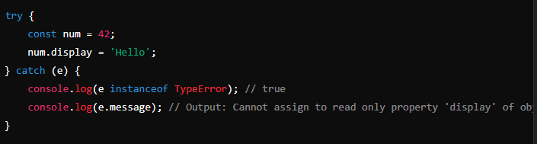
Error Object
TypeError
A TypeError occurs when an operation is performed on a variable that is of an unexpected type, or when trying to change a value that cannot be changed.

Slide 15
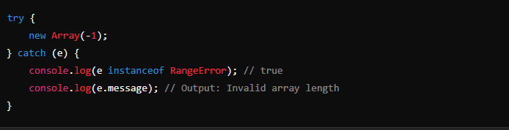
Error Object
RangeError
A RangeError is thrown when a numeric variable or parameter is outside of its valid range.

Slide 16
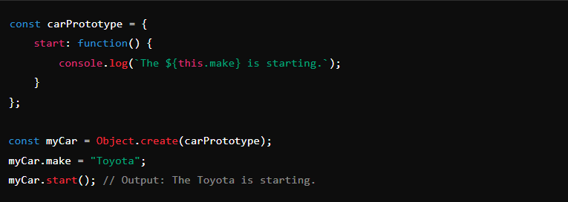
Object.create()
method in JavaScript is a powerful tool used to create a new object with the specified prototype object and properties. It's an essential part of JavaScript's prototype-based inheritance model and allows for the creation of an object that directly inherits from another object.

Slide 17
JavaScript Object Prototypes
Every function in JavaScript has a prototype property that is used when creating instances of that function via the new keyword. Objects created in this way inherit properties and methods from the prototype.

Slide 18
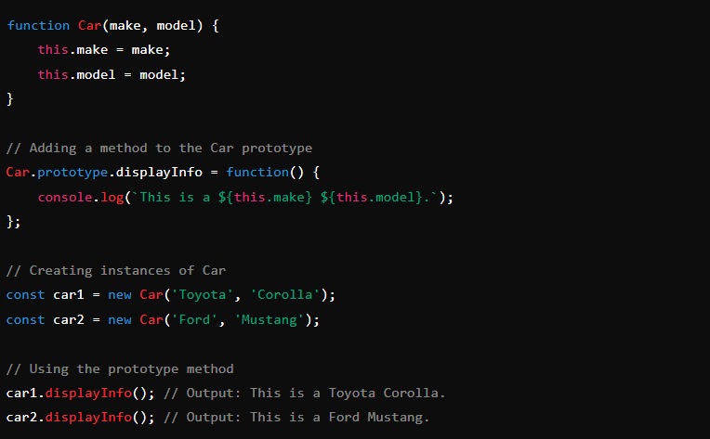
JavaScript Object Prototypes
Adding Methods to a Constructor's Prototype

Slide 19
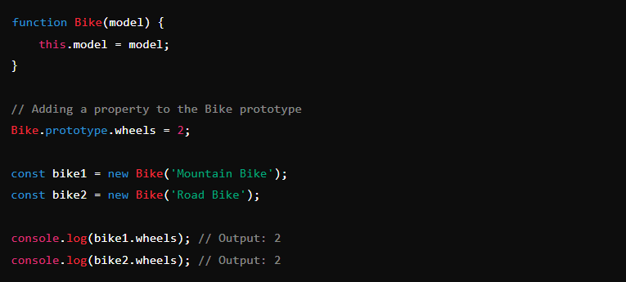
JavaScript Object Prototypes
Adding Properties to a Constructor's Prototype

Slide 20
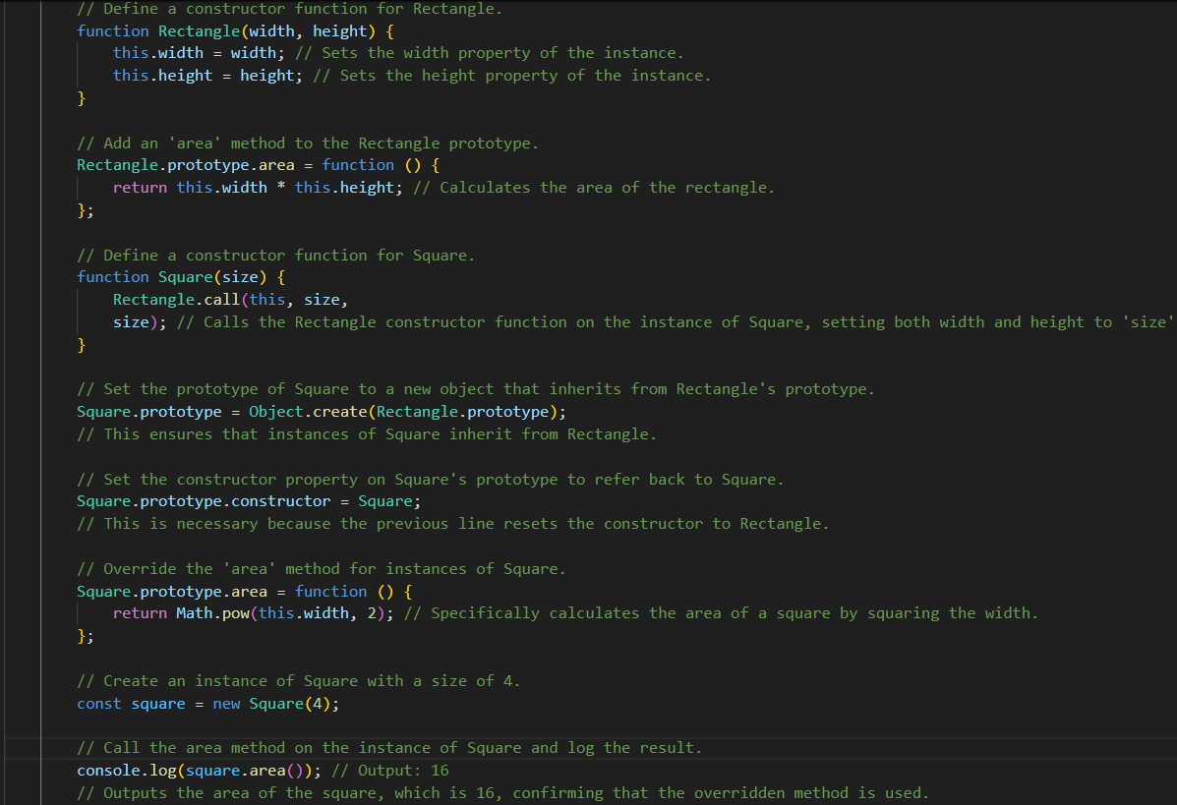
JavaScript Object Prototypes

Slide 21
Data Descriptors
Data descriptors are properties that have a value, which can optionally be writable. The attributes of a data descriptor are:
value: The value of the property.
writable: Boolean indicating whether the property can be changed.
enumerable: Boolean indicating whether the property will be included in loops like for...in.
configurable: Boolean indicating whether the property descriptor can be changed and if the property can be deleted.

Slide 22
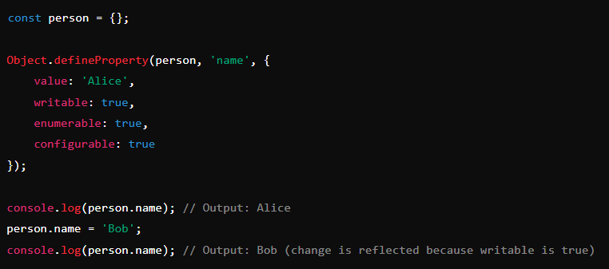
Data Descriptors

Slide 23
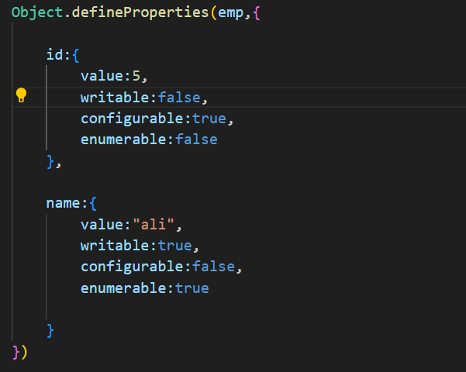
Data Descriptors

Slide 24
Accessor Descriptors
Accessor descriptors are properties defined as a pair of getter-setter functions rather than a simple value. They do not have a value or writable attribute but instead have:
get: A function which serves as a getter for the property, or undefined if no getter is provided.
set: A function which serves as a setter for the property, or undefined if no setter is provided.
enumerable: Like in data descriptors, it denotes whether the property is loopable.
configurable: Like in data descriptors, it denotes whether the property can be reconfigured or deleted.

Slide 25
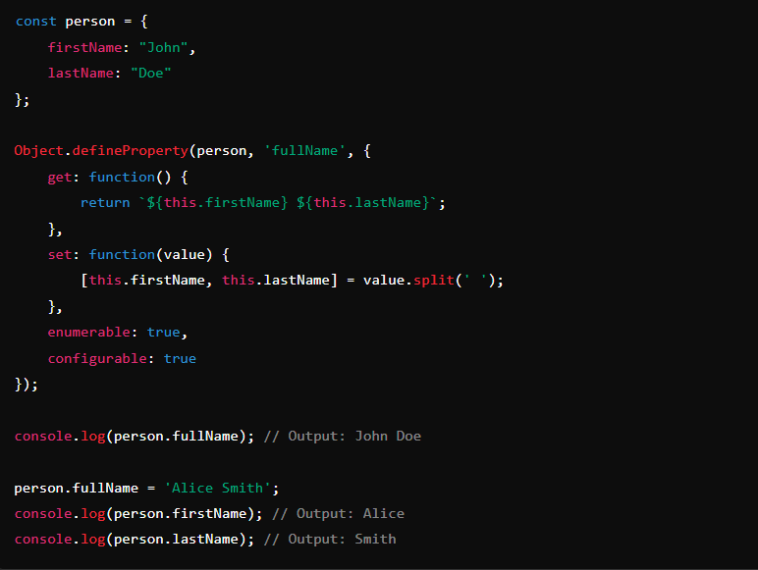
Accessor Descriptors

Slide 26
Thanks!
Do you have any questions?
asmaaahmed23762@gmail.com

